Slide 1
Building a Successful Collaboration
Loris Taylor, President and CEO Native Public Media

Slide 2
Social Justice is People Centered
Human development thrives when information, cultural, social, economic, political, and environmental factors converge to create living conditions that fulfill basic needs and empower individuals and communities.

Slide 3
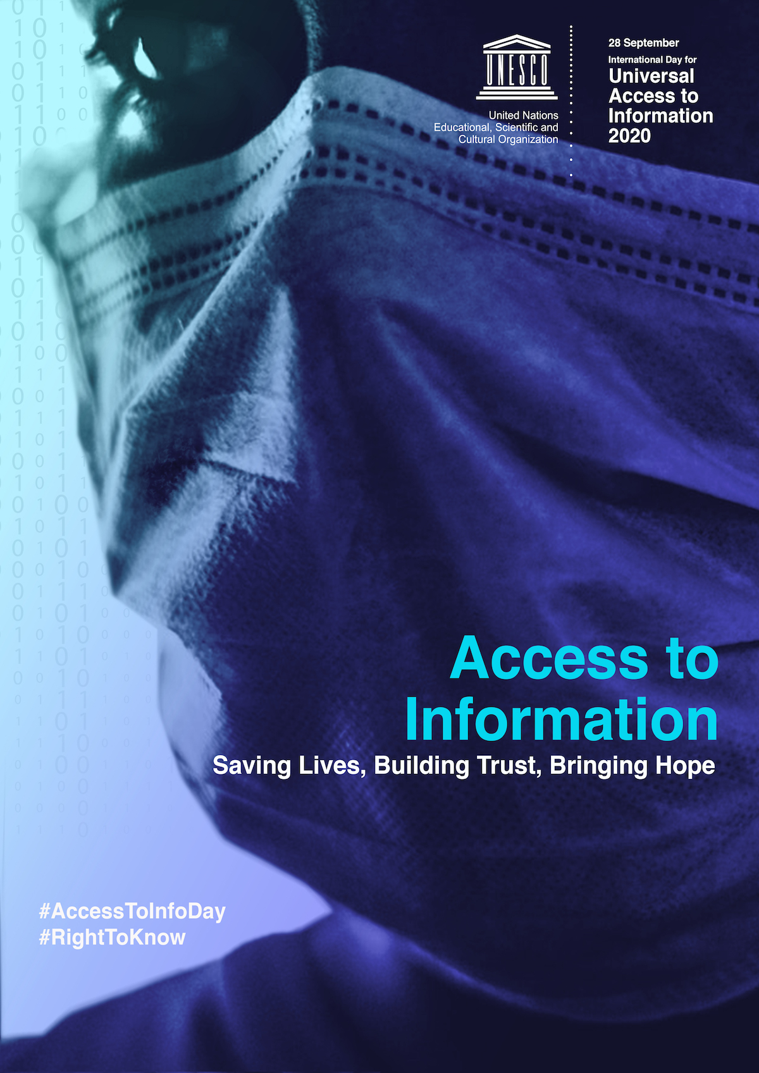
Universal Access to Information is Necessary to Human Development

Slide 4
Humanity’s greatest global challenge is accessing good and truthful information.

Slide 5
Technological advances bring many people closer together and pushes some people apart.

Slide 6
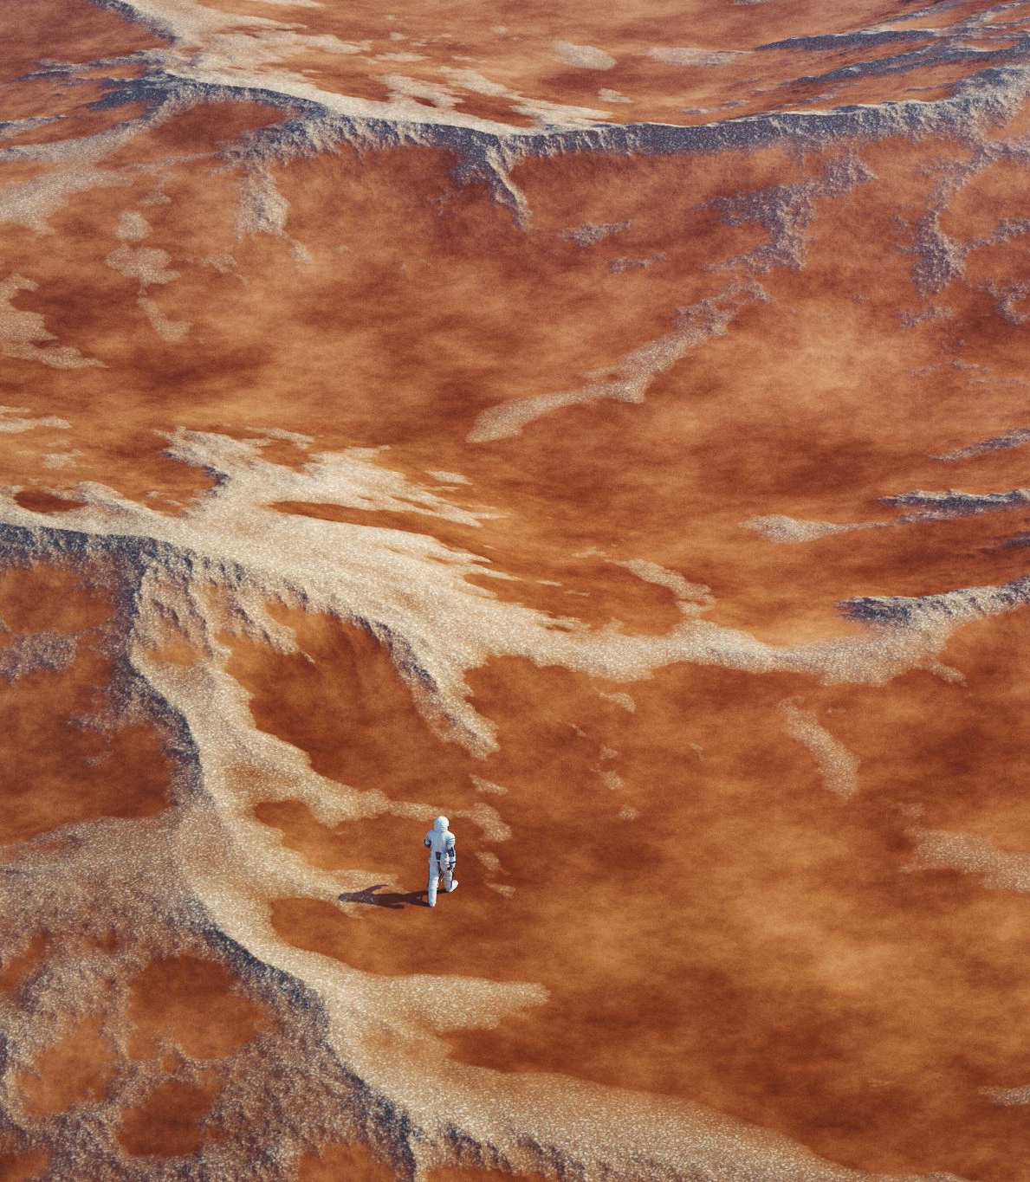
News deserts push people apart and hurt human development.

Slide 7
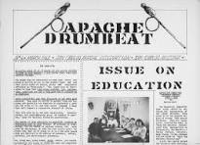
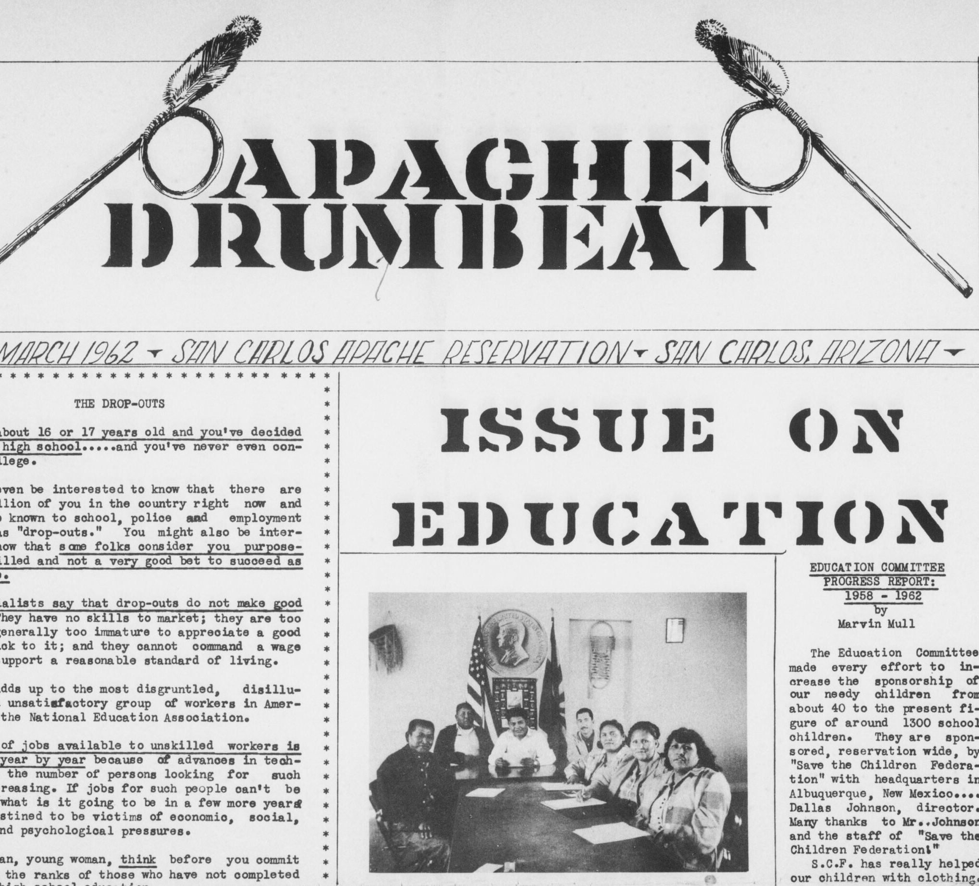
Factual information gives Tribal citizens a stronger feeling of belonging.

Slide 8
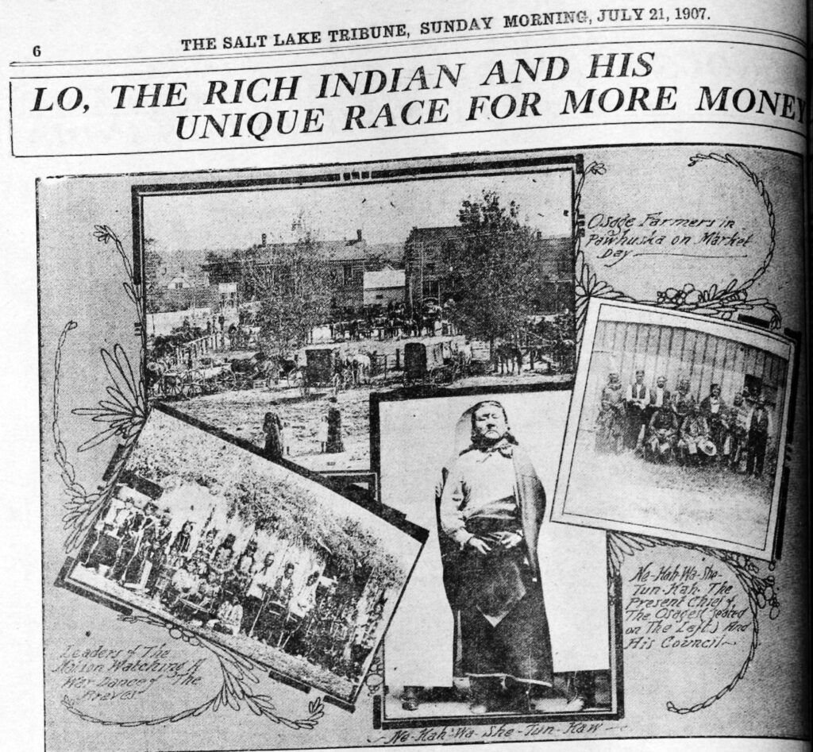
Having our own media outlets keeps Tribal citizens informed, builds trust, and reduces the spread of misinformation.

Slide 9
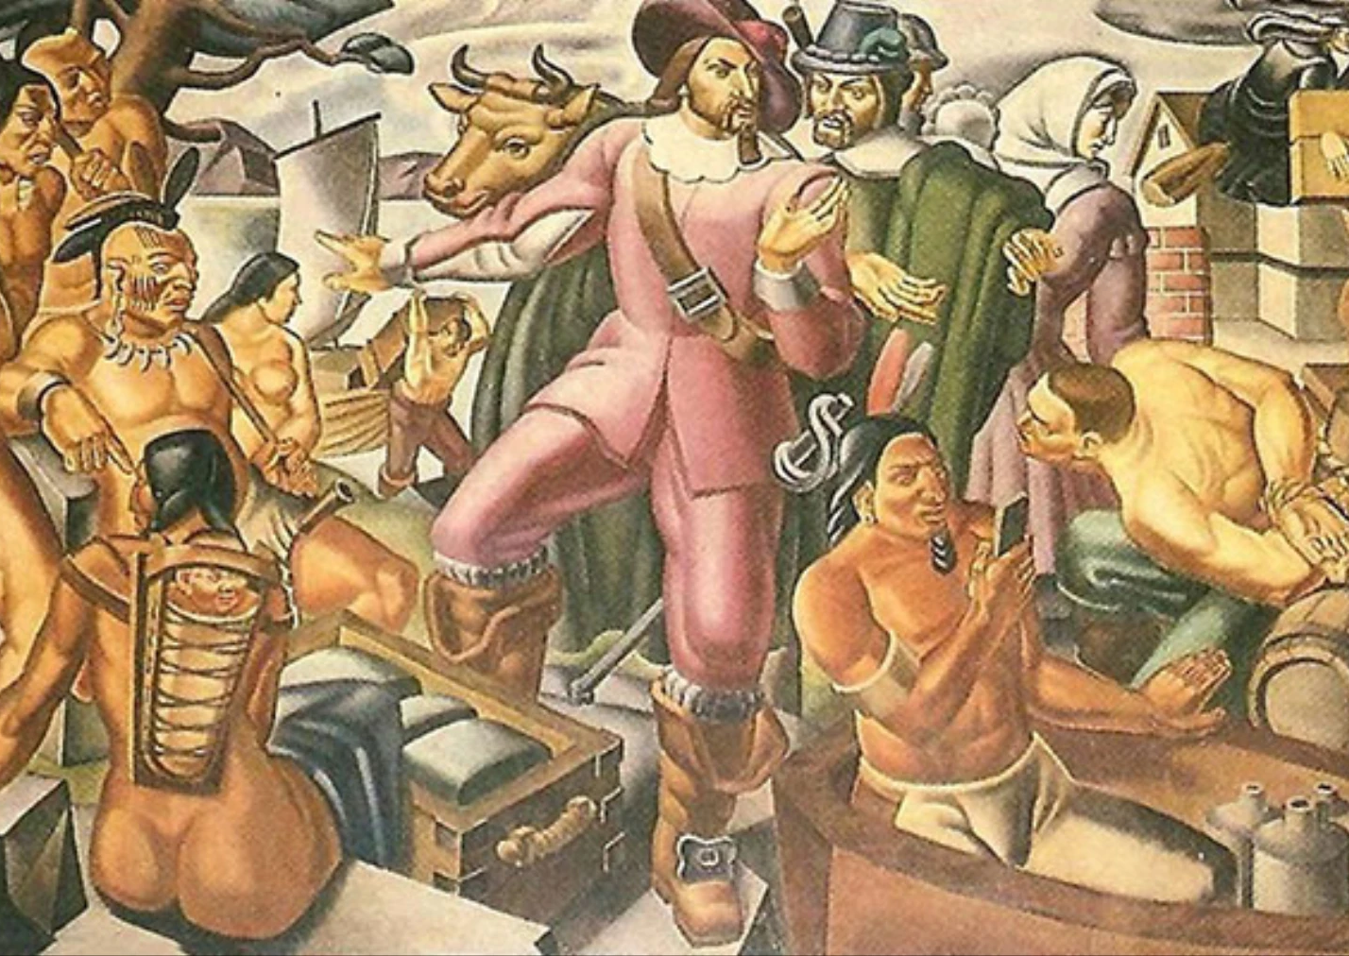
Having a healthy buffet of news informs our decision making.

Slide 10
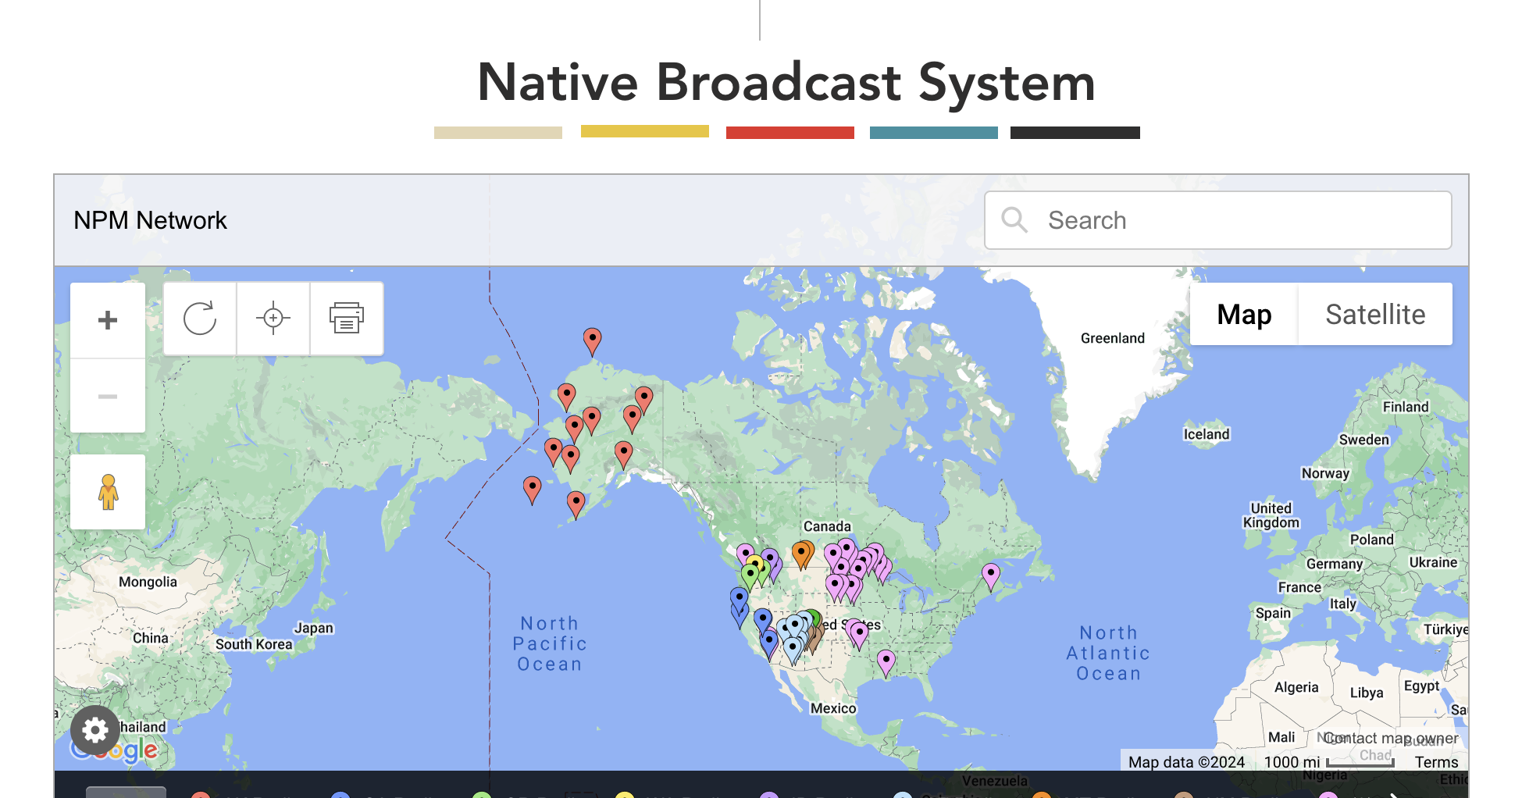
The Mountain West News Bureau Covers Colorado, Idaho, Nevada, Wyoming, and Tribal Reservations

Slide 11
Thank you

